Slide 1
ECON 672
Week 9: Two-Way Fixed Effects with Differential Timing
Samuel Rowe, PhD 2/2/2023

Slide 2
Overview
Two-Way Fixed Effects with Differential Timing
The Takeaway
Two-Way Fixed Effects
Bacon Decomposition Theorem (Cunningham, 2020; Goodman-Bacon, 2021)
Potential Outcomes
Decomposition of Variance-Weighted ATT
Examples

Slide 3
Overview
Two-Way Fixed Effects with Differential Timing
The Two-Way Fixed Effects with Difference-in-Differences (TWFEDD)
A weighted average of all potential 2x2 Difference-in-Differences (DD) estimates where weights are based on group size and variance in treatment
Differential timing can occur when different treatment clusters adopt at different times
For example, several states may implement similar programs, but the implementation of these programs occurs at different times
The Bacon Decomposition Theorem shows that you will have biased estimate of the ATT
The Bacon Decomposition Theorem shows that TWFEDD is a variance-weighted ATT

Slide 4
The Takeaway
Two-Way Fixed Effects with Differential Timing
Pros
We can utilize variation in timing in the implementation of programs, policies, or treatments, which is common among states
The main assumption, Variance-weighed common trend, is slightly weaker than parallel trends
Cons
Like 2x2 DD, we can only estimate the ATT and not the ATE
Heterogeneity in time can bias our estimates even if the variance-weighted common trend assumption is satisfied
Heterogeneity Treatment Bias occurs when we compare late adopters to early adopters

Slide 5
The Takeaway
Two-Way Fixed Effects with Differential Timing
Assumptions
Variance-weighted Common Trends Assumption
This is similar to parallel trends assumption but a bit weaker
Stable Unit Treatment Value Assumption
Testable Assumptions
We can indirectly test the Variance-weighted Common Trends Assumption

Slide 6
Diff-in-Diff and TWFEDD
Comparison

Slide 7

Diff-in-Diff and TWFEDD
The Premise
Given federalist nature of the U.S., states have a lot of discretion to govern themselves and implement programs and policies
When state adopt similar programs or policies, they usually do so at different times
Goodman-Bacon (2019) considers this staggered assignment of treatment across geographic units over time to be “differential timing” of treatment
Until the Goodman-Bacon (2019), we did not have a good idea of the Difference-in-Difference design when staggered adoption was present

Slide 8
Diff-in-Diff and TWFEDD
Estimation
Canonical 2x2 Difference-in-Difference
$$Y_{it}=α+βD_{i}+τPost_{t}+δ(D×Post)_{it}+λX_{it}+ε_{it}$$
Two-Way Fixed Effects Difference-in-Differences (TWFEDD) where time differentials can be considered
$$Y_{it}=α_{0}+δD_{it}+λX_{it}+α_{i}+α_{t}+ε_{it}$$
Where $Y_{it}$ is our outcome of interest
$α_{s}$ is our group fixed effects
$α_{t}$ is our time fixed effects
$D_{it}$ is our binary treatment variable
It’s called two-way fixed effects, since we have unit fixed effects and time fixed effects

Slide 9
Diff-in-Diff and TWFEDD
Estimation
Before we delve into the details, let’s just look at the two categories of TWFEDD
Estimates
All possible 2x2 DD are included
Weights
Group Size
Group Time in Treatment

Slide 10
Bacon-Goodman Decomposition Theorem

Slide 11
Bacon-Goodman Decomposition Theorem
Overview
Goodman-Bacon (2019) provides a decomposition of the two-way fixed effects estimator
The Bacon-Goodman (2021) Decomposition Theorem states that
“Assume that the data contain $k=1,...,K$ timing groups of units ordered by the time when they receive a binary treatment, $k∈(1,T]$. There may be one timing group, $U$, that includes units that never receive treatment. The OLS estimate, ${\overset{̂}{β}}^{DD}$, in a two-way fixed effects regression is a weighted average of all possible two-by-two DD estimators.”

Slide 12
Bacon-Goodman Decomposition Theorem
Overview
The Bacon-Goodman Decomposition Theorem states that
Is a variance-weighted average of all potential 2x2 DD estimates
Where weights are based upon group size (or group share) and variance in treatment (or time share)
Under the assumption of variance-weighted common trends and time-invariant treatment effects
If treatment effects are time varying, there is a new bias that shows up
Recall 2x2 DD estimate is: ${\overset{̂}{δ}}_{kU}^{2x2}=({\overline{y}}_{k}^{post(k)}-{\overline{y}}_{k}^{pre(k)})-({\overline{y}}_{U}^{post(k)}-{\overline{y}}_{U}^{pre(k)})$

Slide 13
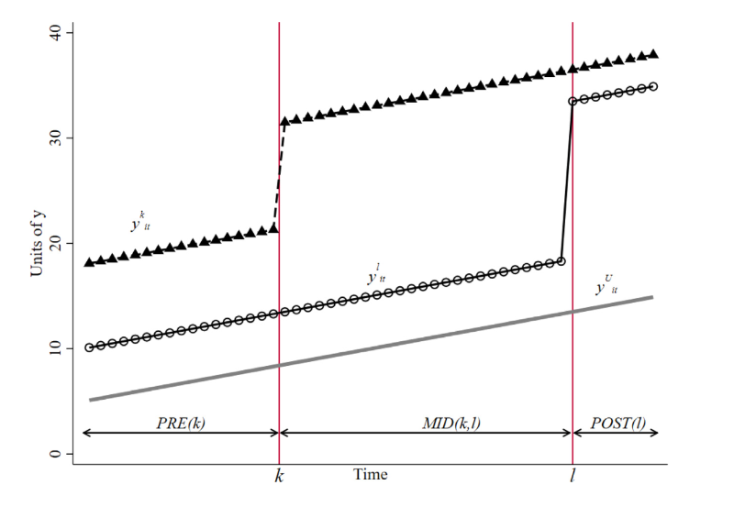
Bacon-Goodman Decomposition Theorem
Overview
With a TWFEDD with Time Differential
We have 3 groups
Early Treatment $k$
Late Treatment $l$
Never Treatment $U$

Slide 14
Bacon-Goodman Decomposition Theorem
Overview
For each 2x2 DD, we can write a general estimator
$${\overset{̂}{δ}}_{ab}^{2x2,j}$$
Where $j$ is the treatment group index
Where $a,b$ are our two groups being compared
For example, ${\overset{̂}{δ}}_{kU}^{2x2,k}$ and ${\overset{̂}{δ}}_{lU}^{2x2,l}$

Slide 15
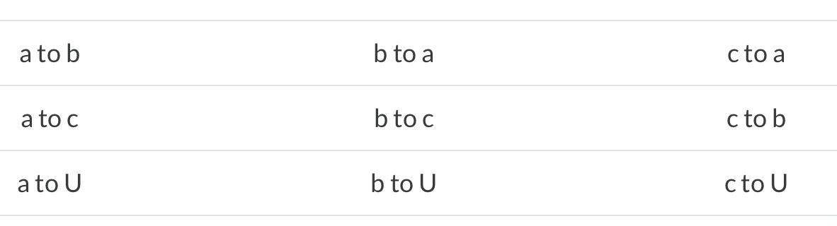
Bacon-Goodman Decomposition Theorem
Overview
The Two-Way Fixed Effects DD is a combination of all possible 2x2 DD
If we have 3 groups: early adopter $k$, late adopter $l$, and never adopter $U$
Then we have 4 total 2x2 DD: ${\overset{̂}{δ}}_{kU}^{2x2,k}$, ${\overset{̂}{δ}}_{kl}^{2x2,k}$, ${\overset{̂}{δ}}_{lU}^{2x2,l}$, and ${\overset{̂}{δ}}_{lk}^{2x2,l}$
If we have 4 groups: adopter $a$, adopter $b$, adopter $c$, and never adopter $U$
Then we have 9 total 2x2 DD

Slide 16
Bacon-Goodman Decomposition Theorem
Weights and Variance Treatment
The weights for each 2x2 DD depends on the group size and variance in treatment
Length of time spent in treatment determines the variance in treatment, which influences the 2x2 DD weight
The weight of the 2x2 DD determines how much influence a particular 2x2 DD has
Variance is maximized when time in treatment is 50%

Slide 17
Bacon-Goodman Decomposition Theorem
Weights and Variance Treatment
Let’s say that there are 5 periods
The early adopter gets treatment in 2nd period and spend 80% of the time in treatment
$${\overline{D}}_{k}=0.8$$
The late adopter gets treatment in 4th period and spends 40% of the time in treatment
$${\overline{D}}_{l}=0.4$$

Slide 18
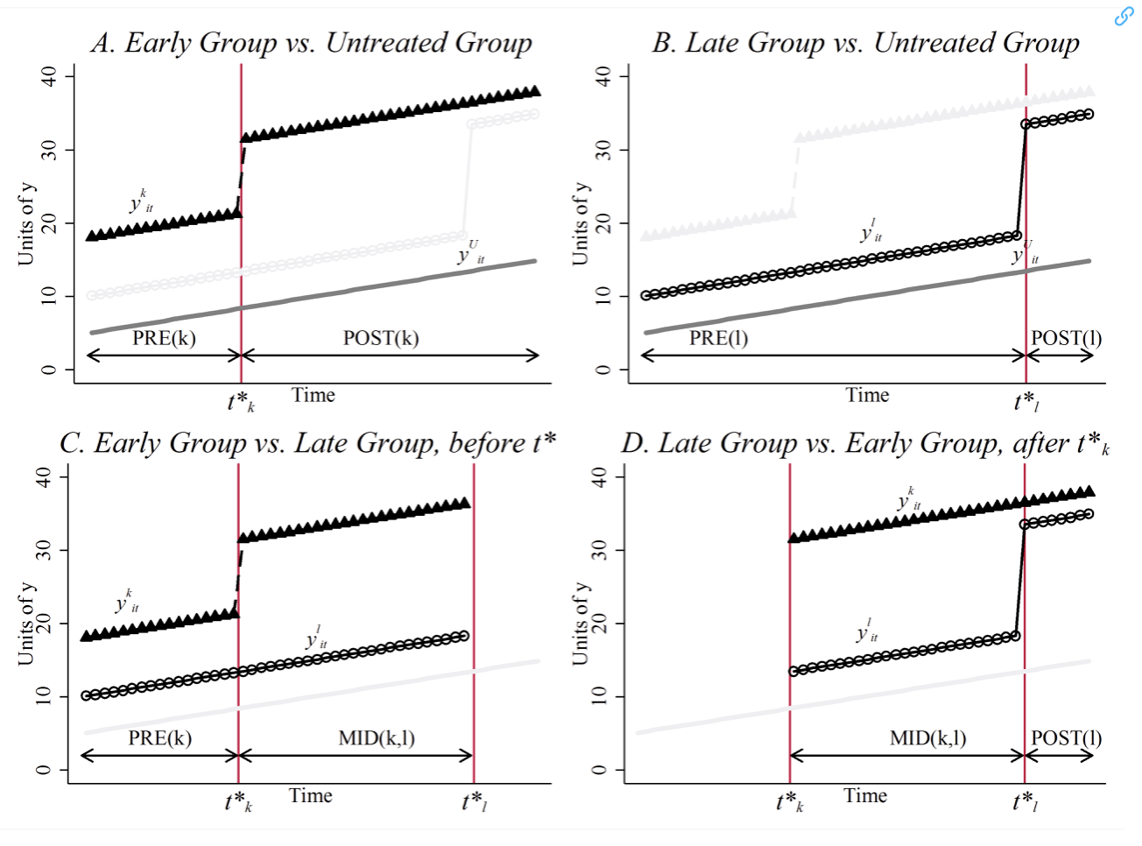
Bacon-Goodman Decomposition Theorem
Overview
We have two treatment groups $k$ and $l$ and an untreated group $U$
Treatment for $k$ occurs at $t_{k}^{*}$ and treatment for $l$ occurs at $t_{l}^{*}$ in
We have pre and post for $k$ at $t_{k}^{*}$ and pre and post for $l$ at $t_{l}^{*}$
In the early period, no one is treated; in the mid period $k$ is treated; in the late period, $k$ and $l$ are treated

Slide 19
Bacon-Goodman Decomposition Theorem
Overview
We have 4 2x2 DD estimates
$${\overset{̂}{δ}}_{kU}^{2x2,k}=({\overline{y}}_{k}^{post(k)}-{\overline{y}}_{k}^{pre(k)})-({\overline{y}}_{U}^{post(k)}-{\overline{y}}_{U}^{pre(k)})$$
$${\overset{̂}{δ}}_{lU}^{2x2,l}=({\overline{y}}_{l}^{post(l)}-{\overline{y}}_{l}^{pre(l)})-({\overline{y}}_{U}^{post(l)}-{\overline{y}}_{U}^{pre(l)})$$
$k$ compared to untreated $l$
$${\overset{̂}{δ}}_{kU}^{2x2}=({\overline{y}}_{k}^{mid(k,l)}-{\overline{y}}_{k}^{pre(k)})-({\overline{y}}_{l}^{mid(k,l)}-{\overline{y}}_{l}^{pre(k)})$$
$l$ compared to already treated $k$
$${\overset{̂}{δ}}_{kU}^{2x2}=({\overline{y}}_{l}^{post(l)}-{\overline{y}}_{l}^{mid(k,l)})-({\overline{y}}_{k}^{post(l)}-{\overline{y}}_{k}^{mid(k,l)})$$

Slide 20
Bacon-Goodman Decomposition Theorem
Estimator
TWFEDD is a composition of of all possible 2x2 DD estimates
$${\overset{̂}{δ}}^{DD}=\underset{k≠U}{∑}s_{kU}{\overset{̂}{δ}}_{kU}^{2x2}+\underset{k≠U}{∑}\underset{l>k}{∑}[s_{kl}{\overset{̂}{δ}}_{kl}^{2x2,k}+s_{lk}{\overset{̂}{δ}}_{lk}^{2x2,l}]$$
Assume that we have a balanced panel with $T$ time periods and $N$ cross-sectional units
Where
${\overset{̂}{δ}}_{ab}^{2x2,j}$ are our DD estimates
$s_{ab}$ are our weights for each DD estimate

Slide 21
Bacon-Goodman Decomposition Theorem
Estimator
${\overset{̂}{δ}}_{ab}^{2x2,j}$ are our DD estimates
$j$ treatment compared to never untreated $U$
$${\overset{̂}{δ}}_{kU}^{2x2,k}=({\overline{y}}_{k}^{post(k)}-{\overline{y}}_{k}^{pre(k)})-({\overline{y}}_{U}^{post(k)}-{\overline{y}}_{U}^{pre(k)})$$
$${\overset{̂}{δ}}_{lU}^{2x2,l}=({\overline{y}}_{l}^{post(l)}-{\overline{y}}_{l}^{pre(l)})-({\overline{y}}_{U}^{post(l)}-{\overline{y}}_{U}^{pre(l)})$$
$k$ compared to untreated $l$
$${\overset{̂}{δ}}_{kU}^{2x2}=({\overline{y}}_{k}^{mid(k,l)}-{\overline{y}}_{k}^{pre(k)})-({\overline{y}}_{l}^{mid(k,l)}-{\overline{y}}_{l}^{pre(k)})$$
$l$ compared to already treated $k$
$${\overset{̂}{δ}}_{kU}^{2x2}=({\overline{y}}_{l}^{post(l)}-{\overline{y}}_{l}^{mid(k,l)})-({\overline{y}}_{k}^{post(l)}-{\overline{y}}_{k}^{mid(k,l)})$$

Slide 22
Bacon-Goodman Decomposition Theorem
Estimator
Weights
$s_{jU}=\frac{(n_{j}+n_{U})^{2}{\overset{̂}{V}}_{jU}^{D}}{{\overset{̂}{V}}^{D}}$ and ${\overset{̂}{V}}_{jU}^{D}=n_{kU}(1-n_{jU}){\overline{D}}_{j}(1-{\overline{D}}_{j})$
$s_{kl}=\frac{((n_{k}+n_{l})(1-{\overline{D}}_{l}))^{2}{\overset{̂}{V}}_{kl}^{D,k}}{{\overset{̂}{V}}^{D}}$ and ${\overset{̂}{V}}_{kl}^{D,k}=n_{kl}(1-n_{kl})\frac{{\overline{D}}_{k}-{\overline{D}}_{l}}{1-{\overline{D}}_{l}}\frac{1-{\overline{D}}_{k}}{1-{\overline{D}}_{l}}$
$s_{lk}=\frac{((n_{k}+n_{l})(1-{\overline{D}}_{k}))^{2}{\overset{̂}{V}}_{lk}^{D,l}}{{\overset{̂}{V}}^{D}}$ an ${\overset{̂}{V}}_{lk}^{D,l}=n_{kl}(1-n_{kl})\frac{{\overline{D}}_{l}}{{\overline{D}}_{k}}\frac{{\overline{D}}_{k}-{\overline{D}}_{l}}{{\overline{D}}_{k}}$

Slide 23
Bacon-Goodman Decomposition Theorem
Estimator
Weights
Where ${\overset{̂}{V}}^{D}=\frac{1}{NT}\underset{i}{∑}\underset{t}{∑}{\overset{˜}{D}}_{it}^{2}$
Double demeaned ${\overset{˜}{D}}_{it}=(D_{it}-{\overline{D}}_{i})-(D_{t}-\overline{\overline{D}})$, where grand mean $\overline{\overline{D}}=\frac{1}{NT}\underset{i}{∑}\underset{t}{∑}D_{it}$
and $\underset{k≠U}{∑}s_{kU}+\underset{k≠U}{∑}\underset{l>k}{∑}[s_{kl}^{k}+s_{lk}^{l}]=1$

Slide 24
Bacon-Goodman Decomposition Theorem
Estimator
Weights
$n$ is the sample share for each timing group $(n_{k},n_{l},n_{U})$
$$n_{j}=\underset{i}{∑}1\{t_{i}=j\}/N$$
${\overline{D}}_{j}$ is the time share spent in treatment
$${\overline{D}}_{j}=\underset{t}{∑}1\{t_{i}≥j\}/T$$

Slide 25
Bacon-Goodman Decomposition Theorem
Variance
Two things should pop out with the variance
1) Group variation vs unit-level variation
More states that adopt a program at the same time, the bigger the influence they will have
2) Within-group treatment variance
Treatment variance is maximized at 0.5 $(\overline{D}=0.5)$
$$\overline{D}=0.1;0.1×0.9=0.09$$
$$\overline{D}=0.4;0.4×0.6=0.24$$
$$\overline{D}=0.5;0.5×0.5=0.25$$

Slide 26
Bacon-Goodman Decomposition Theorem
Variance
Goodman-Bacon (2021) notes two issues with variance
Variance is largest when two treatment groups are closer in size and when treatment occurs closer to the middle of the time window
A larger treatment group will have more weight than the smaller treatment group
Within-group treatment variation matters and changing the number of periods changes the weights
Variance is maximized when $\overline{D}=0.5$

Slide 27
Bacon-Goodman Decomposition Theorem
Variance
There are a few notes on variance in treatment timing from Cunningham (2020)
1) Group variation vs unit-level variation
More states that adopt a program at the same time, the bigger the influence they will have
2) Within-group treatment variance and treatment variance is maximized at 0.5
$$\overline{D}=0.1;0.1×0.9=0.09$$
$$\overline{D}=0.4;0.4×0.6=0.24$$
$$\overline{D}=0.5;0.5×0.5=0.25$$

Slide 28
Potential Outcomes

Slide 29
Potential Outcomes
Switching Equation
TWFEDD is nothing more than a weighted average of all possible 2-by-2 DD
We can use a switching equation to replace sampling averages with potential outcomes
Our observed outcome (what we observe)
$$y_{it}=D_{it}Y_{it}^{1}+(1-D_{it}Y_{it}^{0})$$
Our potential outcome in date range $W$ with $T_{W}$ periods
$$ATT_{k}(τ)≡E[Y_{iτ}^{1}-Y_{iτ}^{0}|t_{i}=k]$$
Where $k$ is our treatment group and $τ$ is the time when $k$ is treated and $(t_{i}=k)$ means that “given the treatment group got the treatment in time $τ$“

Slide 30
Potential Outcomes
Switching Equation
In practice $W$ will represent post-treatment window
$$ATT_{k}(W)≡\frac{1}{T_{W}}\underset{τ∈W}{∑}E[Y_{iτ}^{1}-Y_{iτ}^{0}|t_{i}=k]$$
The difference over time in average potential outcomes
$$Y_{k}^{0}(W_{1},W_{0})≡\frac{1}{T_{W_{1}}}\underset{t∈W_{1}}{∑}E[Y^{0}|t_{i}=k]-\frac{1}{T_{W_{0}}}\underset{t∈W_{0}}{∑}E[Y^{0}|t_{i}=k]$$
$$Y_{k}^{1}(W_{1},W_{0})≡\frac{1}{T_{W}}\underset{t∈W_{1}}{∑}E[Y^{1}|t_{i}=k]-\underset{t∈W_{0}}{∑}E[Y^{1}|t_{i}=k]$$
With trends, differences mean potential outcomes is non-zero

Slide 31
Potential Outcomes
Switching Equation
${\overset{̂}{δ}}_{kU}^{2x2}=(E[Y_{j}|Post]-E[Y_{j}|Pre)-(E[Y_{U}|Post]-E[Y_{U}|Pre])$ $=\underset{\text{Switching Equation}}{\underset{⏟}{(E[Y_{j}^{1}|Post]-E[Y_{j}^{0}|Pre])-(E[Y_{U}^{0}|Post]-E[Y_{U}^{0}|Pre])}}+\underset{\text{Add 0}}{\underset{⏟}{0}}$ Where $E[Y_{j}^{0}|Post]-E[Y_{j}^{0}|Post]=0$ $=\underset{\text{ATT}}{\underset{⏟}{(E[Y_{j}^{1}|Post]-E[Y_{j}^{0}|Post])}}+\underset{\text{NonParallel Trend Bias}}{\underset{⏟}{(E[Y_{j}^{0}|Post]-E[Y_{j}^{0}|Pre])-(E[Y_{U}^{0}|Post]-E[Y_{U}^{0}|Pre])}}$

Slide 32
Potential Outcomes
Switching Equation
This can be rewritten as ${\overset{̂}{δ}}_{kU}^{2x2}=ATT_{Post,j}+\underset{\text{NonParallel Selection Bias}}{\underset{⏟}{ΔY_{Post,Pre,j}^{0}-ΔY_{Post,Pre,U}^{0}}}$
If the Parallel Trend assumption holds for each individual 2x2 DD, then the ATT is identified
We aren’t done yet

Slide 33
Potential Outcomes
Switching Equation
We have three sets of 2x2 DD
Our 2x2 that we just discussed of treated to untreated $U$
$${\overset{̂}{δ}}_{jU}^{2x2}=ATT_{j}(Post(j))+[ΔY_{j(Post(j),Pre(j))}^{0}-ΔY_{U(Post(j),Pre(j)}^{0}],wherej=k,l$$
A 2x2 DD of treated $k$ to untreated $l$ in the mid period
$${\overset{̂}{δ}}_{kl}^{2x2,k}=ATT_{k}(Mid(k,l))+[ΔY_{k(Mid(k,l),Pre(k))}^{0}-ΔY_{l(Mid(k,l),Pre(k))}^{0}]$$
A 2x2 DD of treated $l$ to already treated $k$ in the late period
${\overset{̂}{δ}}_{lk}^{2x2,l}=ATT_{l}(Post(l))+[ΔY_{l(Post(l),Mid(k,l))}^{0}-ΔY_{k(Post(l),Mid(k,l))}^{0}]-[ATT_{k(Post(l))}-ATT_{k(Mid(k,l))}]$

Slide 34
Potential Outcomes
Switching Equation
Notice that last term on comparing treated $l$ to already treated $k$
$${\overset{̂}{δ}}_{lk}^{2x2,l}=ATT_{l}(Post(l))+[ΔY_{l(Post(l),Mid(k,l))}^{0}-ΔY_{k(Post(l),Mid(k,l))}^{0}]-\underset{\text{Heterogenous in Time Bias}}{\underset{⏟}{[ATT_{k(Post(l))}-ATT_{k(Mid(k,l))}]}}$$
The identification of $ATT_{l}$ involves changes in average treatment effects on the treated over time for already treated group $k$
Even if we have parallel trends for each 2x2 DD, any heterogeneity in time for the average treatment effects for $k$ will introduce bias

Slide 35
Potential Outcomes
Review
Recall that the TWFEDD is
${\overset{̂}{δ}}^{DD}=\underset{k≠U}{∑}s_{kU}{\overset{̂}{δ}}_{kU}^{2x2}+\underset{k≠U}{∑}\underset{l>k}{∑}[s_{kl}{\overset{̂}{δ}}_{kl}^{2x2,k}+s_{lk}{\overset{̂}{δ}}_{lk}^{2x2,l}]$
Each component is (and don’t forget the weight for each)
$${\overset{̂}{δ}}_{jU}^{2x2}=ATT_{j}(Post(j))+[ΔY_{j(Post(j),Pre(j))}^{0}-ΔY_{U(Post(j),Pre(j)}^{0}],wherej=k,l$$
$${\overset{̂}{δ}}_{kl}^{2x2,k}=ATT_{k}(Mid(k,l))+[ΔY_{k(Mid(k,l),Pre(k))}^{0}-ΔY_{l(Mid(k,l),Pre(k))}^{0}]$$
$${\overset{̂}{δ}}_{lk}^{2x2,l}=ATT_{l}(Post(l))+[ΔY_{l(Post(l),Mid(k,l))}^{0}-ΔY_{k(Post(l),Mid(k,l))}^{0}]-[ATT_{k(Post(l))}-ATT_{k(Mid(k,l))}]$$

Slide 36
Decomposition of Variance-Weighted ATT
Overview

Slide 37
Decomposition of Variance-Weighted ATT
Overview
We can simplify our TWFEDD from:
$${\overset{̂}{δ}}^{DD}=\underset{k≠U}{∑}s_{kU}{\overset{̂}{δ}}_{kU}^{2x2}+\underset{k≠U}{∑}\underset{l>k}{∑}[s_{kl}{\overset{̂}{δ}}_{kl}^{2x2,k}+s_{lk}{\overset{̂}{δ}}_{lk}^{2x2,l}]$$
Goodman-Bacon (2021) shows using the probability limit of the TWFEDD:
$plim_{N→∞}{\overset{̂}{δ}}^{DD}=δ^{DD}=VWATT+VWCT-ΔATT$ (Recall: $SDO=ATE+SB+HTB$)
$VWATT$ is the variance-weighted average treatment effect on the treated
$VWCT$ is the variance-weighted common trends
$ΔATT$ is the weighted sum of the change in treatment effects within each time group’s before and after treatment time (heterogeneity in time bias)

Slide 38
Decomposition of Variance-Weighted ATT
Variance-Weighted ATT
The Variance-Weighted Average Treatment Effect on the Treat (VWATT) is the causal parameter that TWFEDD can estimate
$$VWATT≡\underset{k≠U}{∑}σ_{kU}ATT_{k(Post(k)}+\underset{k≠U}{∑}\underset{l>k}{∑}[σ_{kl}^{k}ATT_{k(Mid(k,l))}+σ_{lk}^{l}ATT_{l(Post(l))}]$$
Where
$σ$ are the probability limits of the weights $s$ from earlier
VWATT is a positively weighted average of ATTs for the treatment groups and post-periods across all 2x2 DDs that make up

Slide 39
Decomposition of Variance-Weighted ATT
Variance-Weighted Common Trends
Variance-Weighted Common Trends (VWCT) generalizes the common trends with a timing variation
This is the main assumption of TWFEDD and deals with selection bias
It’s a collection of trends for all of the subcomponents
It’s a bit weaker than the parallel trends assumption
Why don’t we need identical trends like 2x2 DD?
The weights can make common trends hold even if we don’t have exact parallel trends

Slide 40
Decomposition of Variance-Weighted ATT
Variance-Weighted Common Trends
Goodman-Bacon (2021) shows
VWCT is an average of the difference in counterfactual trends between pairs of timing groups and different time periods using the weights from the decomposition theorem
$VWCT≡\underset{k≠U}{∑}σ_{kU}[ΔY_{k(Post(k),Pre(k))}^{0}-ΔY_{U(Post(k),Pre(k)}^{0}]+$ $\underset{k≠U}{∑}\underset{l>k}{∑}[σ_{kl}^{k}\{ΔY_{k(Mid(k,l),Pre(k))}^{0}-ΔY_{l(Mid(k,l),Pre(k))}^{0}\}+$ $σ_{lk}^{l}\{ΔY_{l(Post(l),Mid(k,l))}^{0}-ΔY_{k(Post(l),Mid(k,l))}^{0}\}]$

Slide 41
Decomposition of Variance-Weighted ATT
Heterogeneity in Time Bias
Goodman-Bacon (2021) shows the third term of the decomposition
$$ΔATT≡\underset{k≠U}{∑}\underset{l>k}{∑}σ_{lk}^{l}[ATT_{k(Post(l))}-ATT_{k(Mid(k,l))}]$$
This equals a weighted sum of the change in treatment effects within each timing group before and after a later treatment time
This is the source of heterogeneity in time bias
This does not invalidate the research design, but another estimator might be more appropriate
Even the main assumption of VWCT is satisfied, you can still have bias from HTB

Slide 42
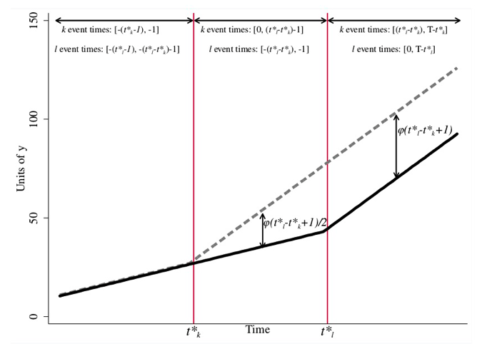
Decomposition of Variance-Weighted ATT
Heterogeneity in Time Bias
There are two sources of heterogeneity treatment bias
Across Groups
Within Time
TWFEDD is concerned with heterogeneity treatment bias within time or time-varying treatment effects
The $ATT_{k}$ at time $t*_{k}$ may differ at time $t_{l}^{*}$

Slide 43
Decomposition of Variance-Weighted ATT
Heterogeneity in Time Bias
Differing post-treatment windows can generate time-varying treatment effects
Even if the counterfactual outcomes are identical, but the treatment effect is a linear break in the trend

Slide 44
Decomposition of Variance-Weighted ATT
Heterogeneity in Time Bias
More problematic when we have a lot of treated to already treated 2x2 DDs
Or, if these 2x2 DDs have large weights
Less problematic if these a few of these 2x2 DDs or they have small weights

Slide 45
Examples
Castle Doctrine and Homicides (Cheng and Hoekstra, 2013)

Slide 46
Examples
Castle Doctrine and Homicides (Cheng and Hoekstra, 2013)
Cheng and Hoekstra (2013) evaluate the impact of gun reform on violence with time differential adoption of gun reform after the death of Trayvon Martin in 2012
Main Result: They find that Castle-Doctrine did not deter crime, but increased homicide
Program/Policy
The authors assess the reform of castle-doctrine statutes (or “Stand Your Ground” laws) on homicides
Reform (Change)
Between 2000 and 2010, 21 states expanded their castle-doctrine by extending the castle-doctrine to outside of the home where lethal force could legally be used
It eliminated the long-standing common law of a victim’s duty to retreat
And, if the victim felt threatened, then they could legally use lethal force

Slide 47
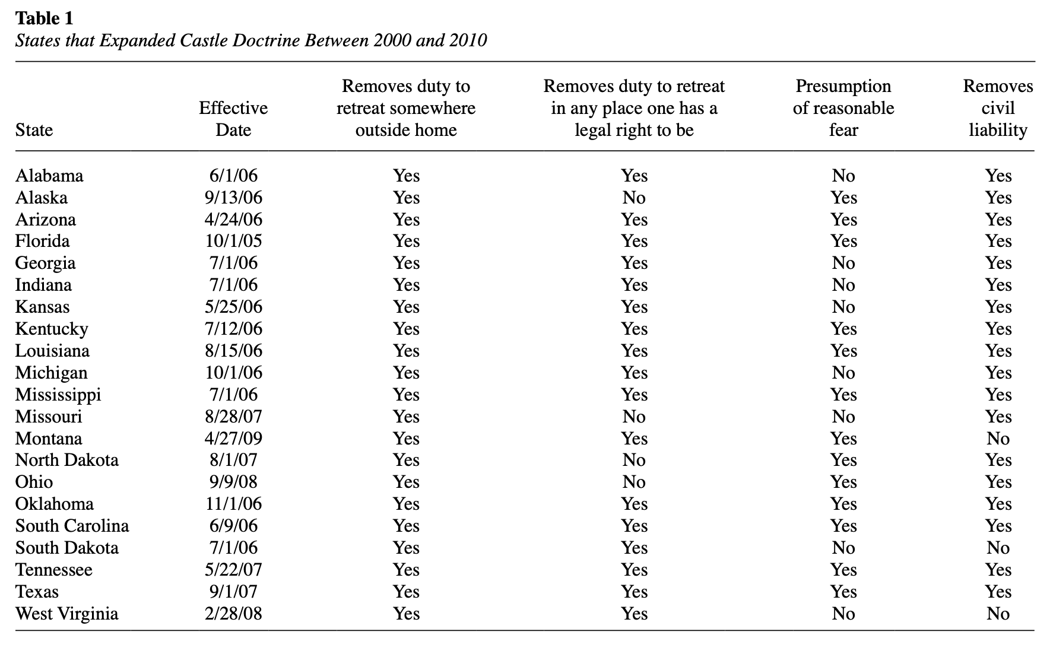
Examples
Castle Doctrine and Homicides (Cheng and Hoekstra, 2013)

Slide 48
Examples
Castle Doctrine and Homicides (Cheng and Hoekstra, 2013)
Theory
These reforms reduced the cost of killing someone on the margin, but reducing the expected costs
Civil liability is lowered, since the policy change made it harder for the prosecutor to say the victim was not in fear
It reduces costs by removing civil liability for manslaughter, but eliminating this constraint
If people are sensitive to incentives, depending on the elasticity of lethal self-defense with respect to cost, we can expect an increase in lethal violence for the marginal victim
If the reformed worked, then we expect homicides to rise
True positive: victim would have been murdered if not for lethal force
False positive: victim would not have been murdered and the change increases homicides relative to the counterfactual

Slide 49
Examples
Castle Doctrine and Homicides (Cheng and Hoekstra, 2013)
Theory (cont)
Cheng and Hoekstra (2013) test of marginal cost theory compared the deterrence theory of Lott and Mustard (1997) and Becker (1968)
Model and Method
Cheng and Hoekstra (2013) utilize a difference-in-difference design,
But there are differential timings in treatment, since states do not adopt castle-doctrine reform simultaneously

Slide 50
Examples
Castle Doctrine and Homicides (Cheng and Hoekstra, 2013)
Model
$$Y_{it}=α+δD_{it}+γX_{it}+λ_{i}+τ_{i}+ε_{it}$$
Where $Y_{it}$ is homicide rate per 100k
$D_{it}$ is usually a binary [0,1],
Slightly modify to account for laws adopted partially into the year, such that a law adopted in July is coded as $D=0.5$
$X_{it}$ are region-by-year fixed effects (so a treatment state’s counterfactual will come from its region) and other covariates
$λ_{i}$ are state fixed effects, $τ_{t}$ are year fixed effects, and $ε_{it}$ is our error term (clustering at state level)

Slide 51
Examples
Castle Doctrine and Homicides (Cheng and Hoekstra, 2013)
Data
FBI Uniform Crime Reports Summary Part 1 files
2000 to 2010 were the years utilized
There are harmonized data set on eight “index” crimes collected from voluntarily participating police administrations
Crimes were converted into a rate of crime per 100,000 people
American Community Survey
Provides median family incomes, poverty, and other social-economic status (SES)

Slide 52
Examples
Castle Doctrine and Homicides (Cheng and Hoekstra, 2013)
Falsification Tests
Non-lethal retaliation in public crimes
Motor vehicle thefts and larcenies
We would expect no impact on these outcomes that should not involve lethal retaliation in public
Potential lethal-retaliation in public crimes
Burglary, robbery, and aggravated assault
We might expect negative effects on these outcomes, since the deterrence hypothesis says these crimes should be deterred
Main Result
Homicides

Slide 53
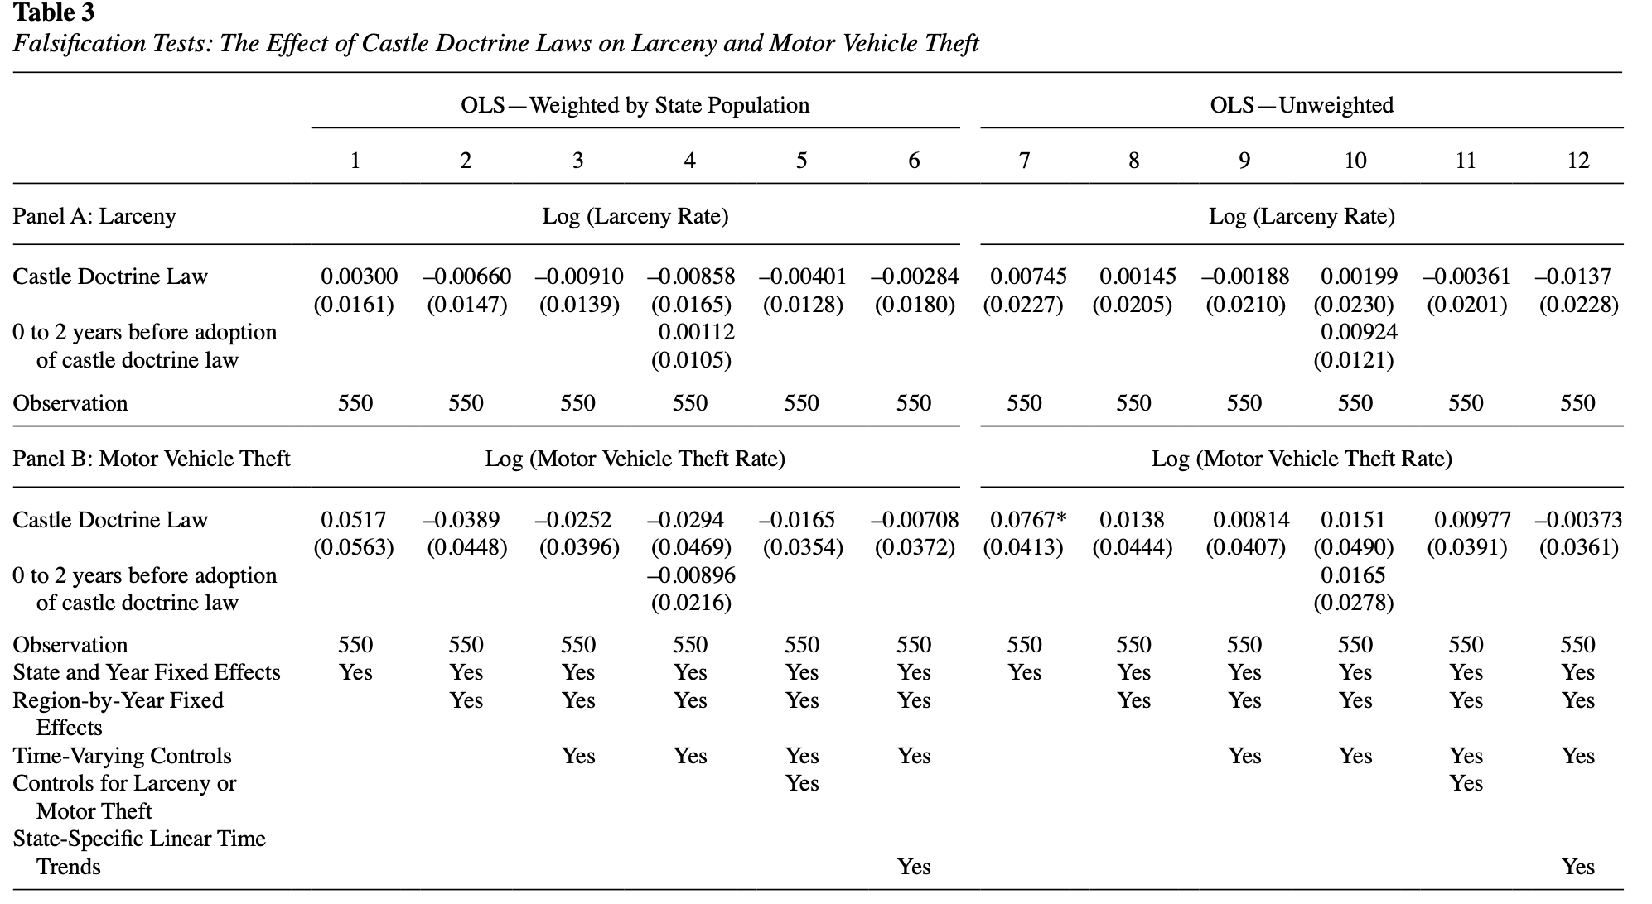
Examples
Castle Doctrine and Homicides (Cheng and Hoekstra, 2013)
Non-lethal force in public crimes
Small and insignificant outcomes
This is what we expect

Slide 54
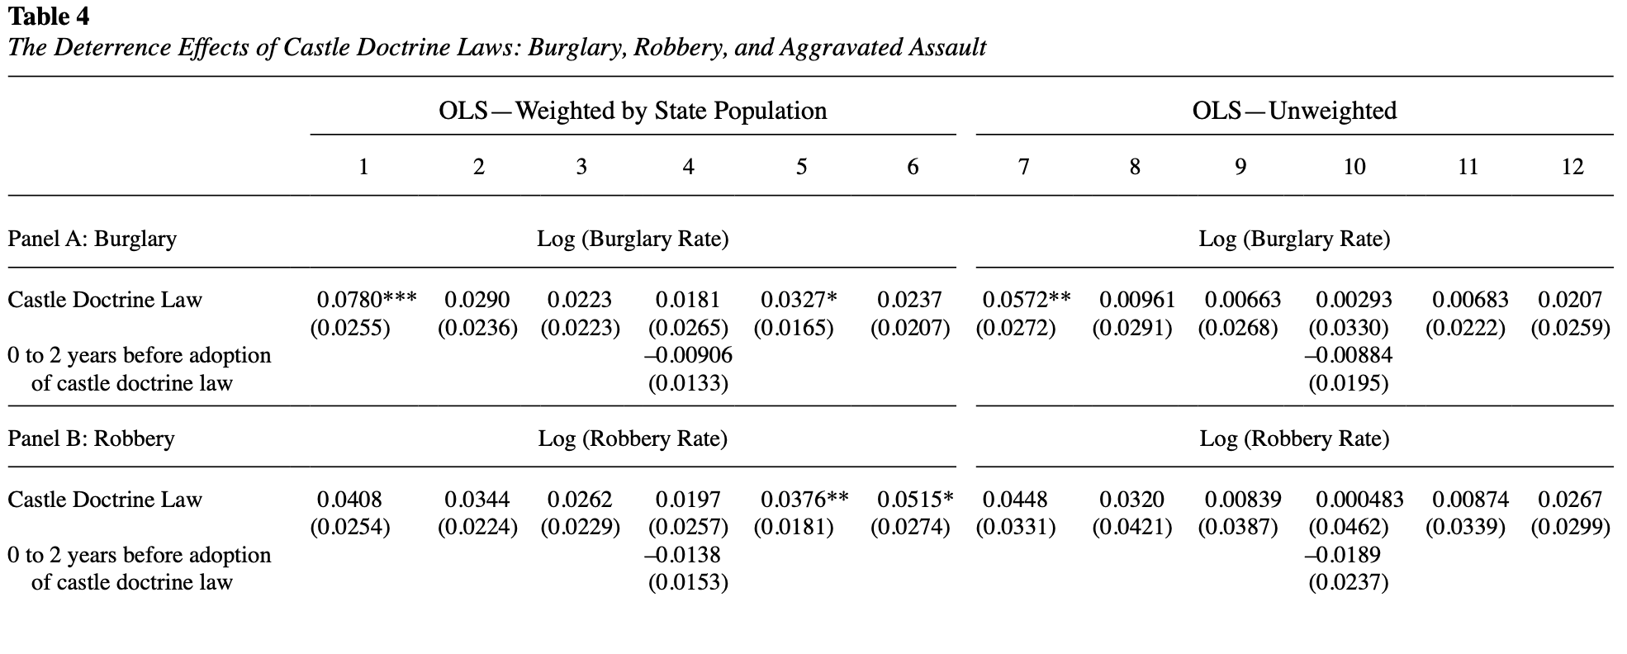
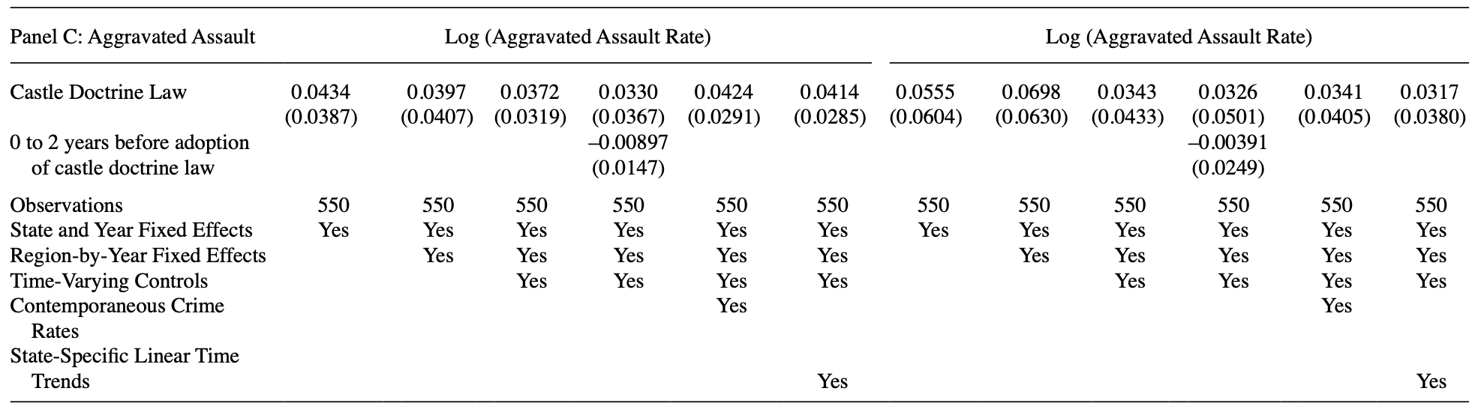
Examples
Castle Doctrine and Homicides (Cheng and Hoekstra, 2013)
Potential Lethal-force falsification tests show positive increases, but mostly insignificant across specification
We should have expected negative effects for deterrence
No evidence of positive spillovers from deterrence

Slide 55
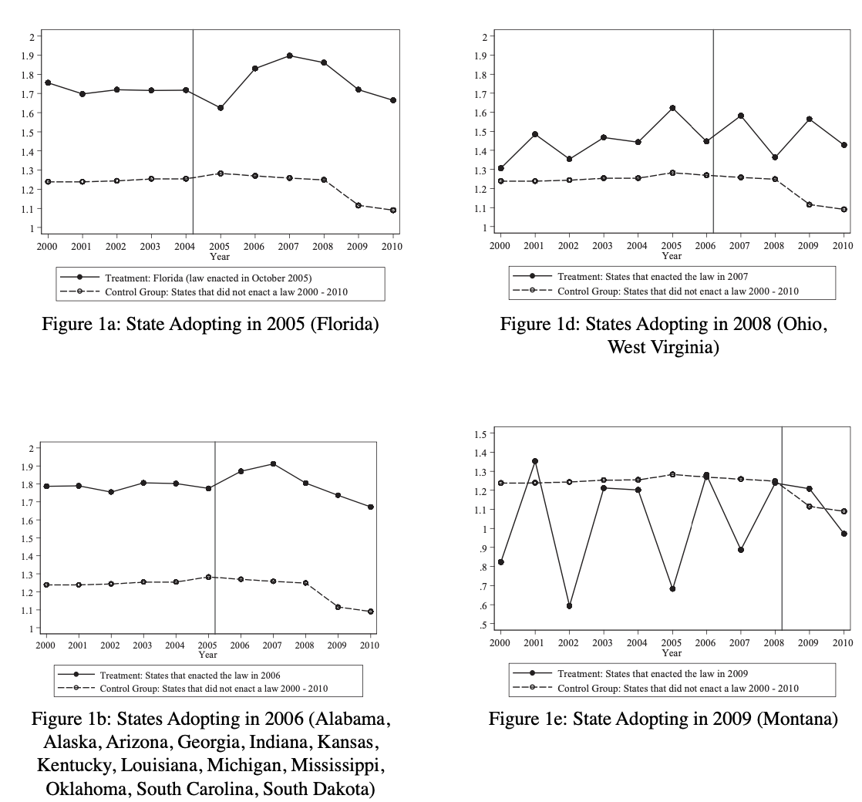
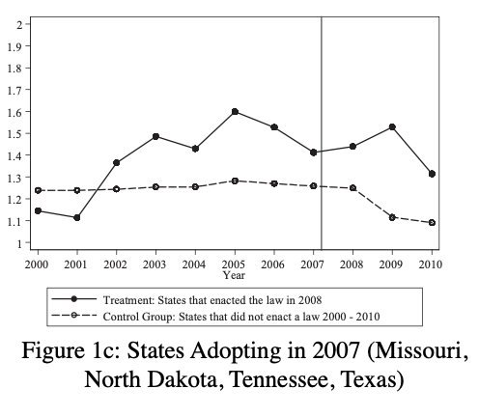
Examples
Castle Doctrine and Homicides (Cheng and Hoekstra, 2013)
The authors provide the plotted raw data for each state by year of adoption of logged homicides per 100K
Offenses appear to be fairly flat for treatment and control
This is not a direct test of the parallel trends but plotting data helps

Slide 56
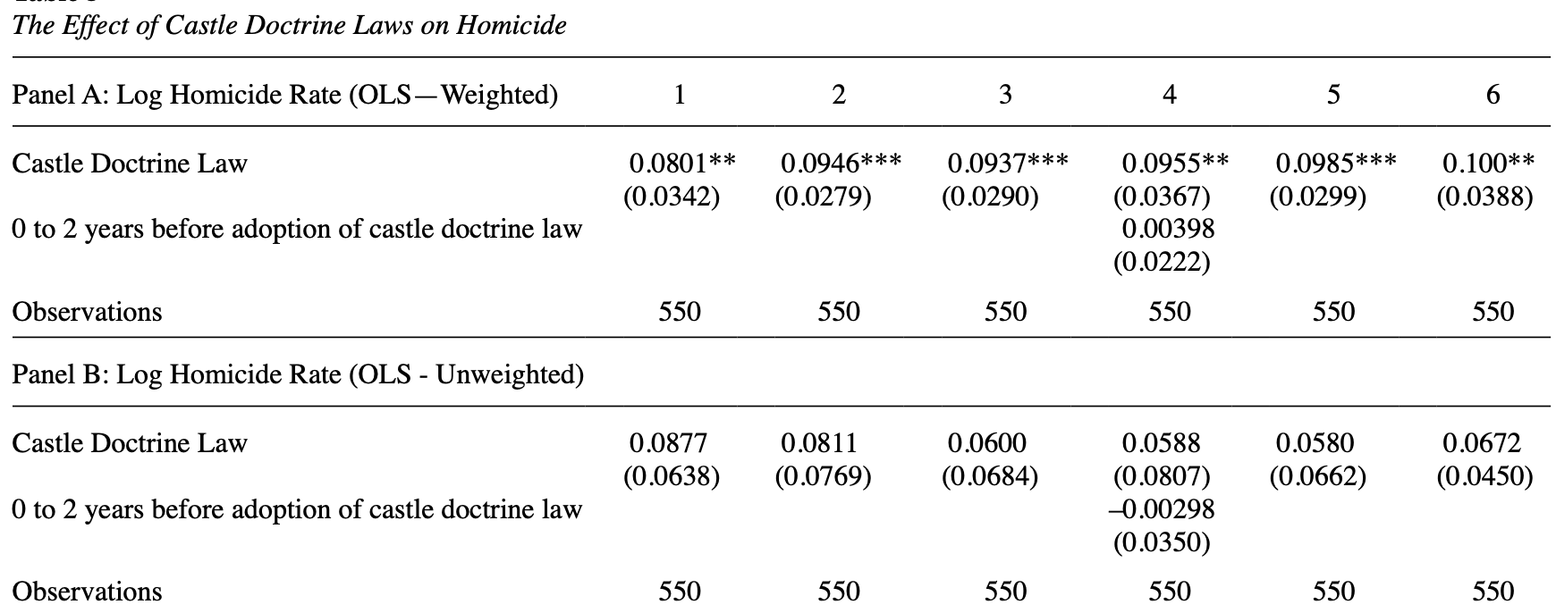
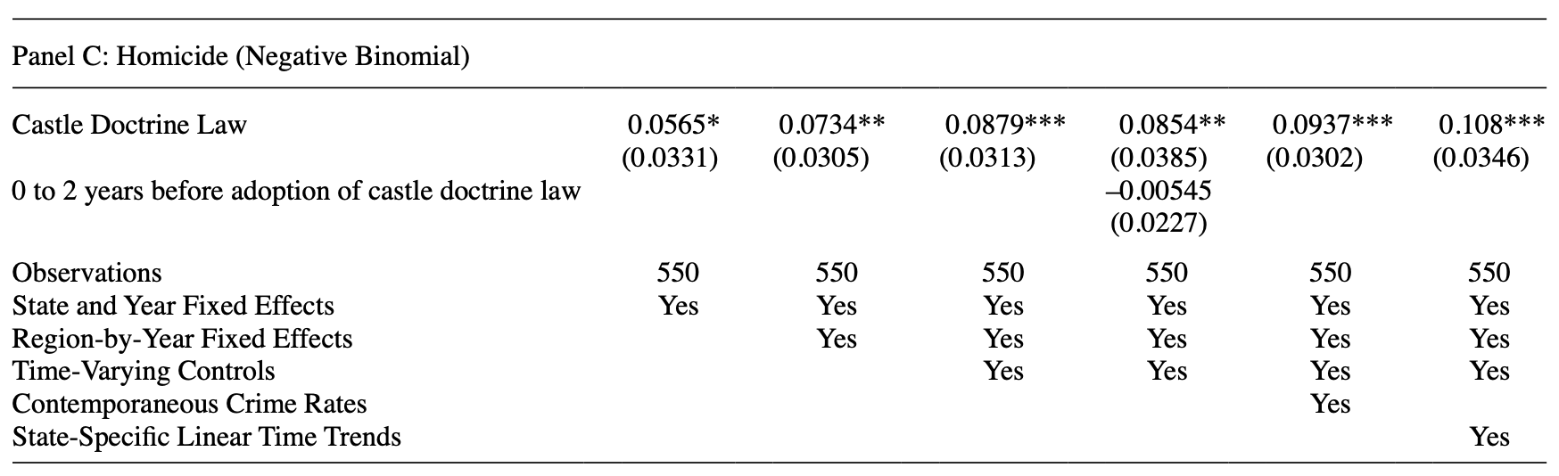
Examples
Castle Doctrine and Homicides (Cheng and Hoekstra, 2013)
The main results show that reducing the marginal cost of lethal force increases homicide rates
Castle-Doctrine reform increases homicide rates by 8.3% to 10.5% or 600 more homicides per year
This result is robust across different specification tests
Evidence for marginal cost

Slide 57
Examples
Stata Example: Replicate Cheng and Hoekstra (2013)
Cheng and Hoekstra (2013) utilized a TWFEDD with time differential (different adoption times) before Bacon-Goodman Decomposition
We will replicate Cheng and Hoekstra, but we will keep the policy binary
We will use leads and lags Event Study
Using coefplot Stata package
We will look at weights of our TWFEDD
Using ddtiming and bacondecomp Stata packages

Slide 58
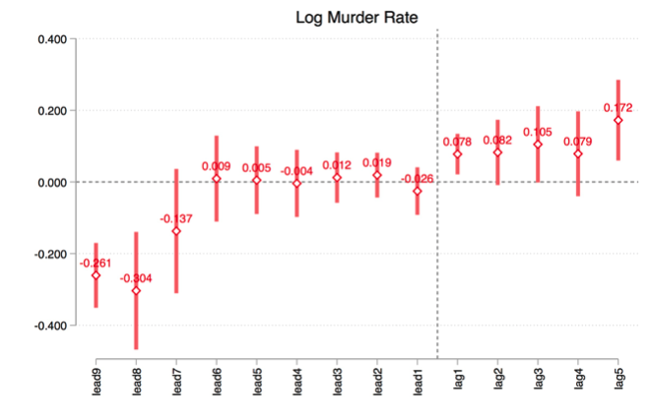
Examples
Stata Example: Replicate Cheng and Hoekstra (2013)
We will add value by adding a Event Study to corroborate Cheng and Hoekstra plotting the raw data
There are some odd leads 8 to 9 years before, but parallel trends for 7 years prior to the policy adoption

Slide 59
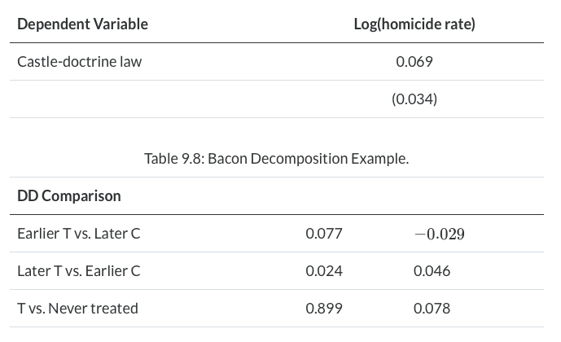
Examples
Stata Example: Replicate Cheng and Hoekstra (2013)
The Bacon-Goodman Decomposition shows that the Castle Doctrine increases homicide rates by 7.1%
Notice the weights, treated to never treated has a weight of 0.89
Notice that the 2x2 DD of early adopter to late adopter is a decline in homicide rates

Slide 60
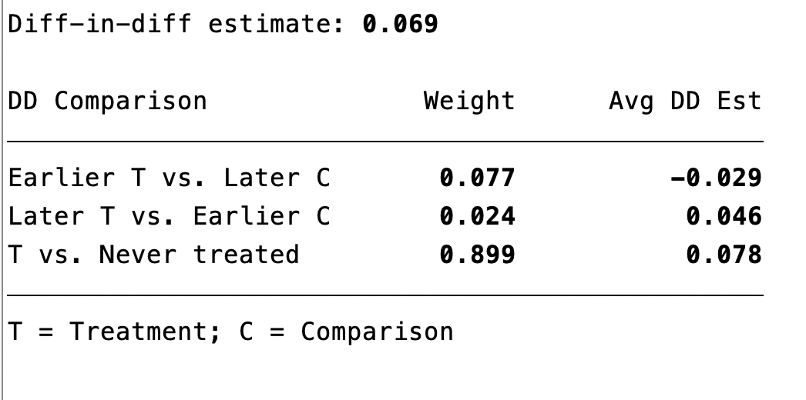
Examples
Stata Example: Replicate Cheng and Hoekstra (2013)
Our result is 0.069
$$(0.077*-0.029)+(0.024*0.046)+(0.899*0.078)=0.069$$

Slide 61
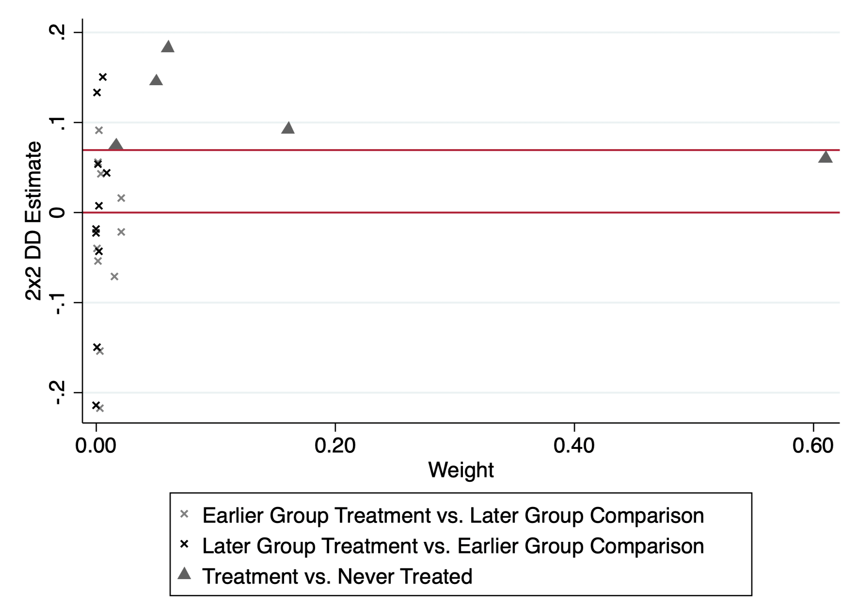
Examples
Stata Example: Replicate Cheng and Hoekstra (2013)
All of our DD estimates can be seen in our DDtiming graph
Most DD estimates have a positive estimate
Most treated to never treated are positive
There is one DD estimate that has over 0.6 of the weight
In addition, most treated to never treated has larger weight

Slide 62
Concluding Remarks
Stata Example: Replicate Cheng and Hoekstra (2013)
There is a lot going on with TWFEDD when we have a lot variation in time adoption
Be cause when you have time differentials using TWFEDD
There is plenty of ongoing work with TWFEDD
Work on weighting
Work on selection of “good” 2x2 DD estimates within our TWFEDD
Work on matrix completion for a full panel
Work on TWFEDD by Borusyak (2021) and did_imputation

